Slide 1
Book of Daniel Class 9 – Chapter 8 Winter 2023
Summarize the vision of Daniel 7.
What is the interpretation?

Slide 2
Daniel 7- Vision of the Four Beast

Slide 3
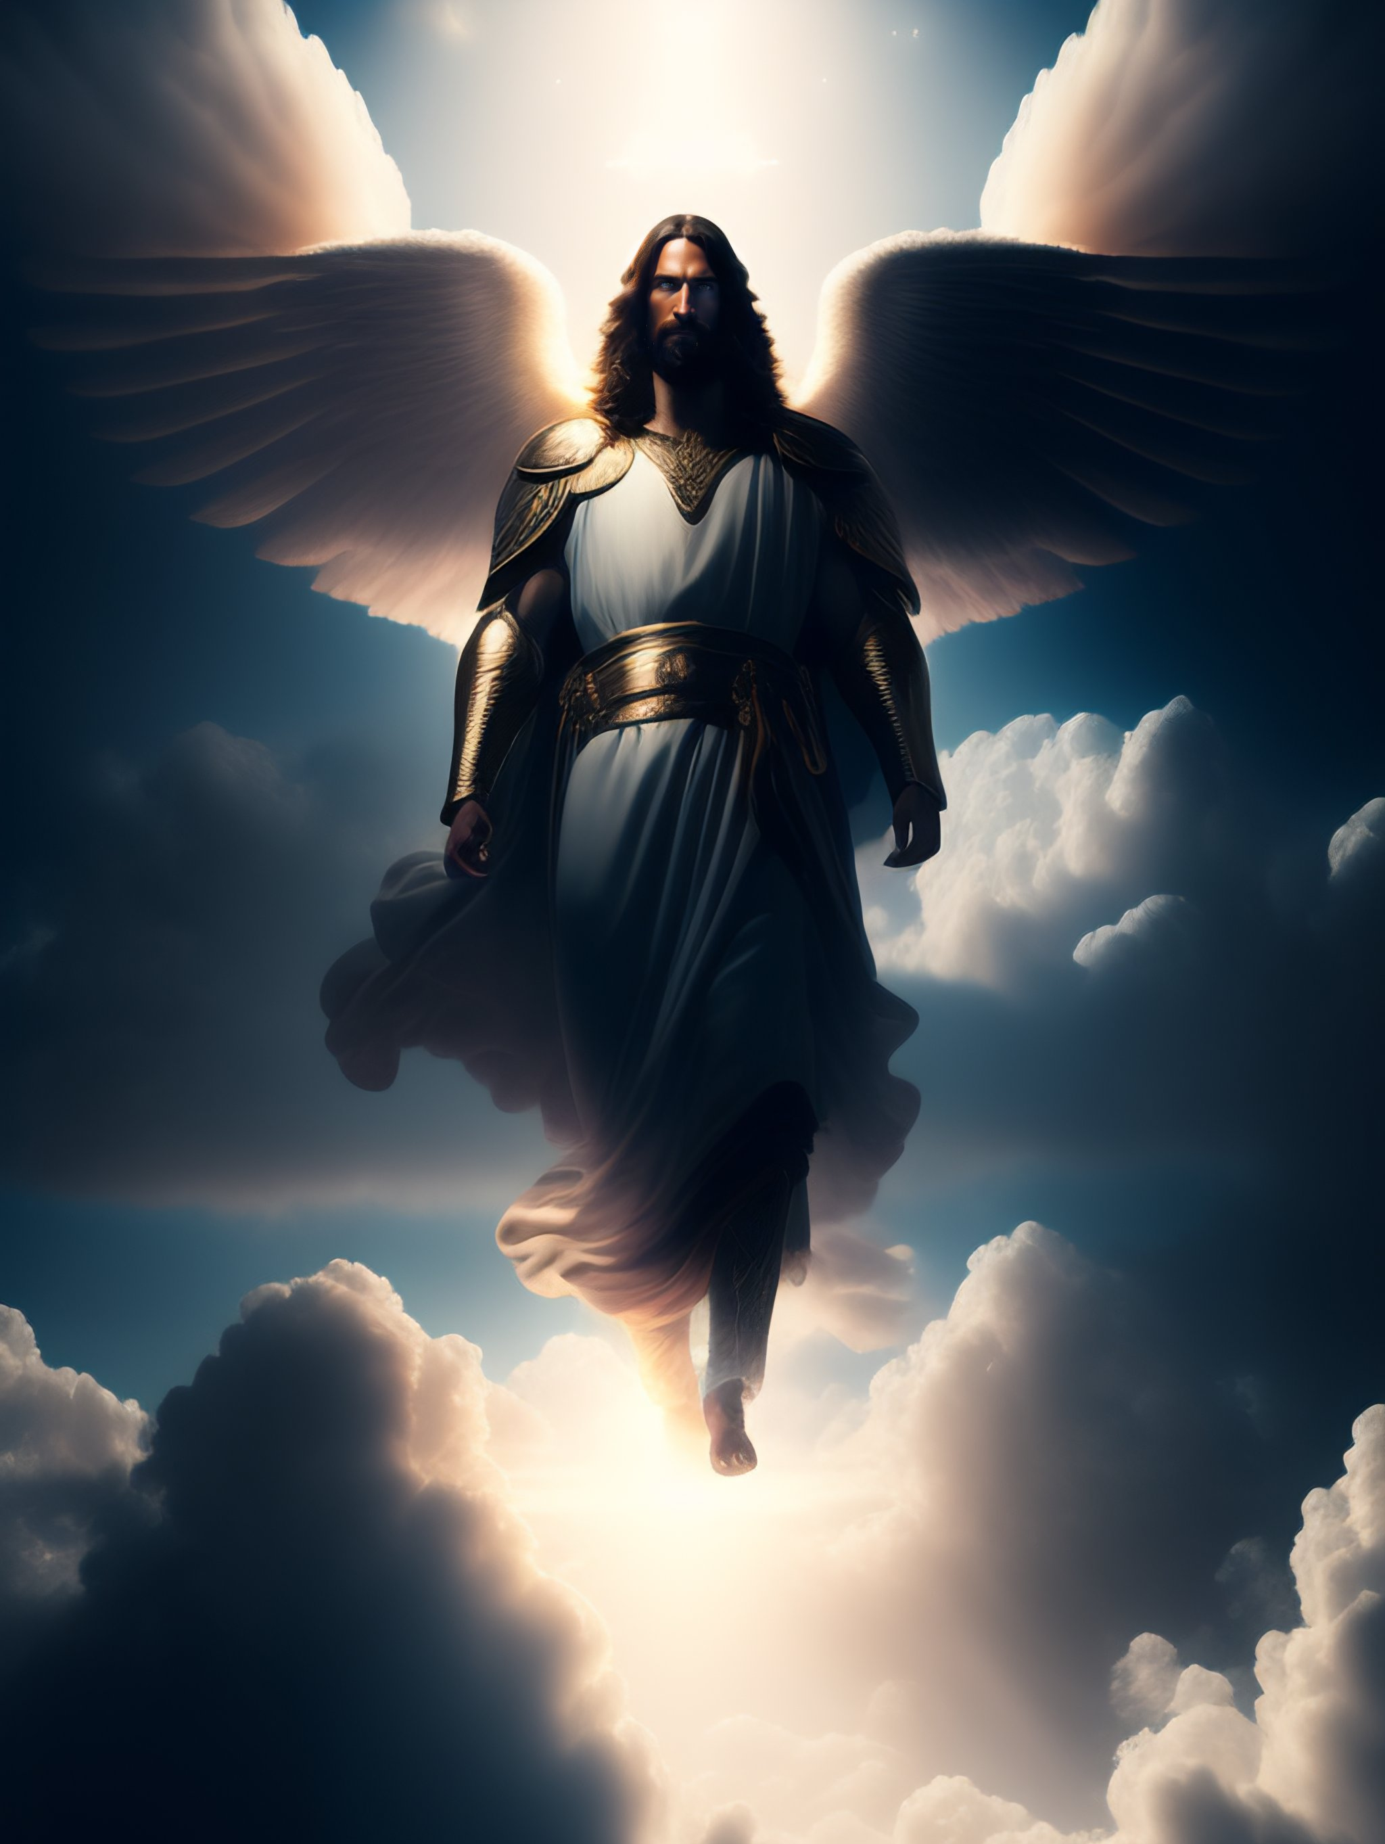
Daniel 7

Slide 4
Daniel – Rough Outline
Style
Ch 1-6: Story
Ch 7-13: Vision
2. The King’s Dream
7. Daniel’s Dream
3. The Fiery Furnace
6. The Lion’s Den
4. Nebuchadnezzar’s Pride
5. Belshazzar’s Pride
8. Daniel’s 2nd Vision
1. Recruited to Serve in Babylon
9. Daniel’s Prayer
10-12. Daniel’s 3rd Vision
HEBREW
ARAMAIC
HEBREW

Slide 5
The Book of Daniel (Structure)
Style:
Ch. 1-6: Story
Ch. 7-12: Vision
Ch. 1 Hebrew
Ch. 2-7
Aramaic
Ch. 8-12
Hebrew
Language:
Prologue
God rules in the kingdoms of man.
God preserves His sacred people.
Theme:

Slide 6
Where are we in Daniel 8

Slide 7
Daniel 8 – Vision of the Ram and Goat
Let’s read the text together…
Make a list of all the similarities to Chapter 7
Make another list of all the differences.

Slide 8
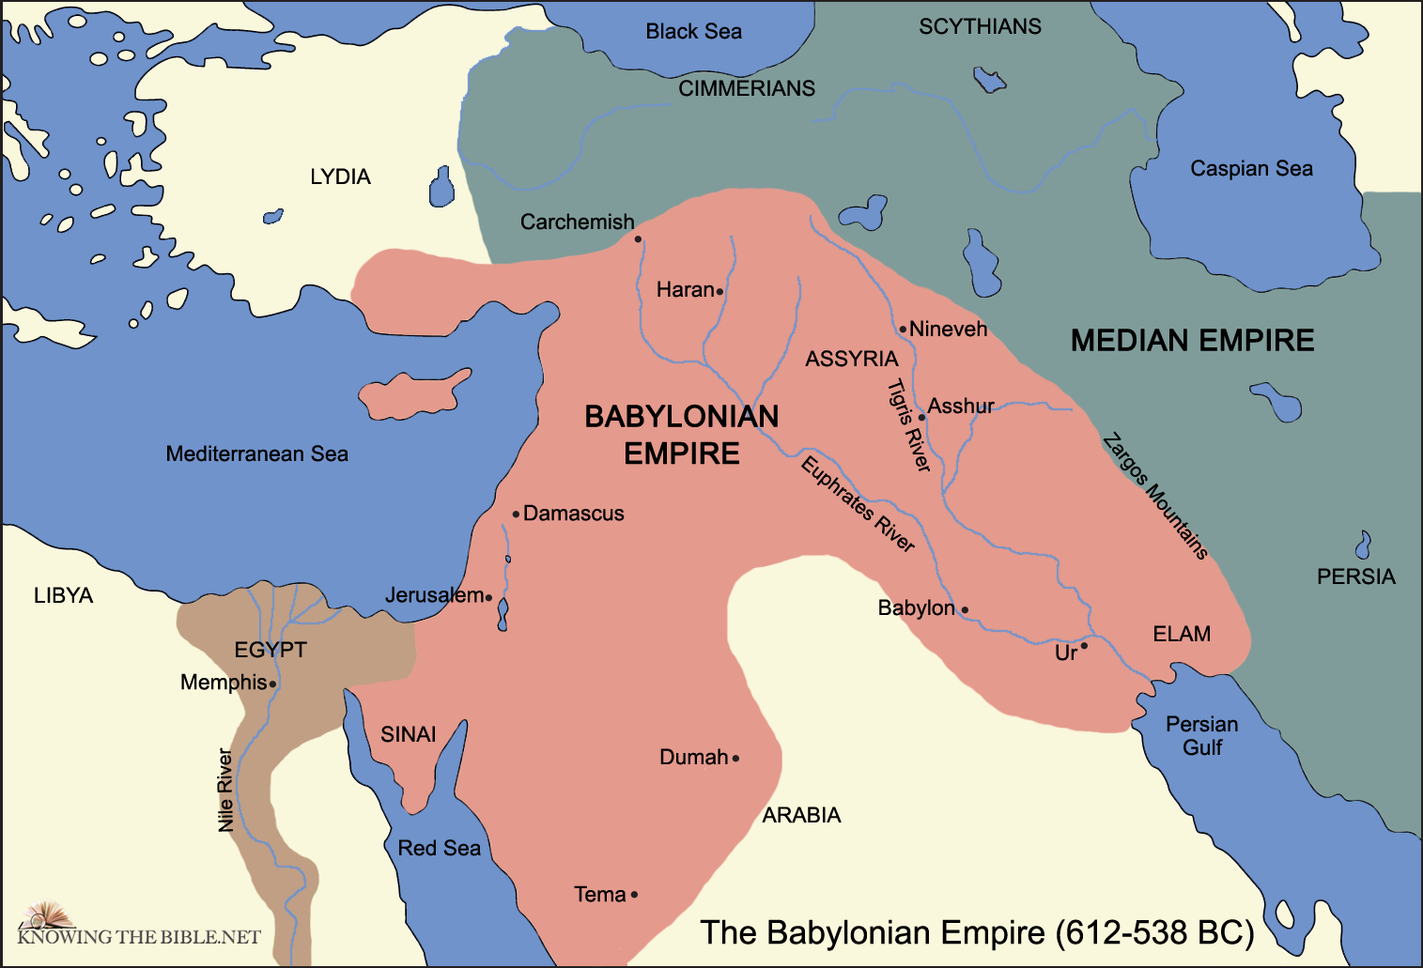

Slide 9
Daniel 8
Daniel “in” Susa (8:2) eventual capital of Persian Empire
Ram a common symbol in Persian iconography
Two horns (8:3, 20)- Medes and Persians
From the east (8:4)
Capture Babylon in 539 BC (5:28-31)

Slide 10
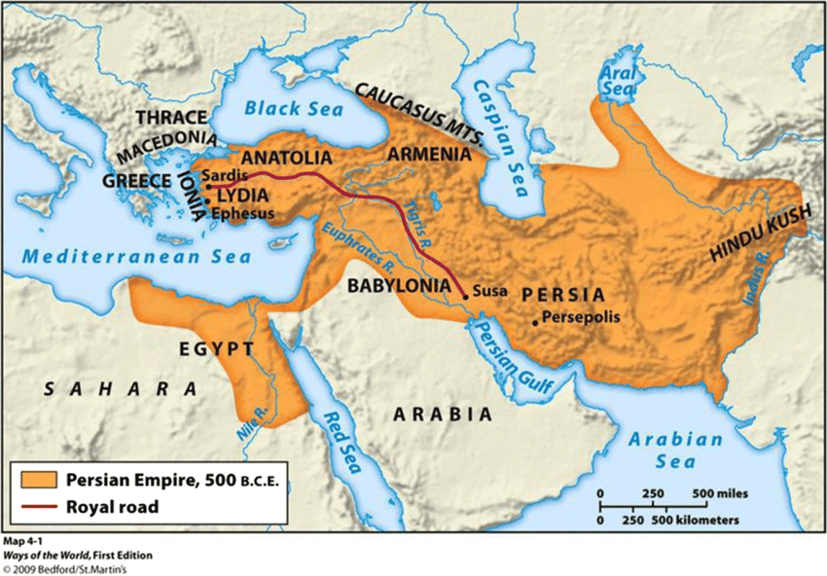

Slide 11
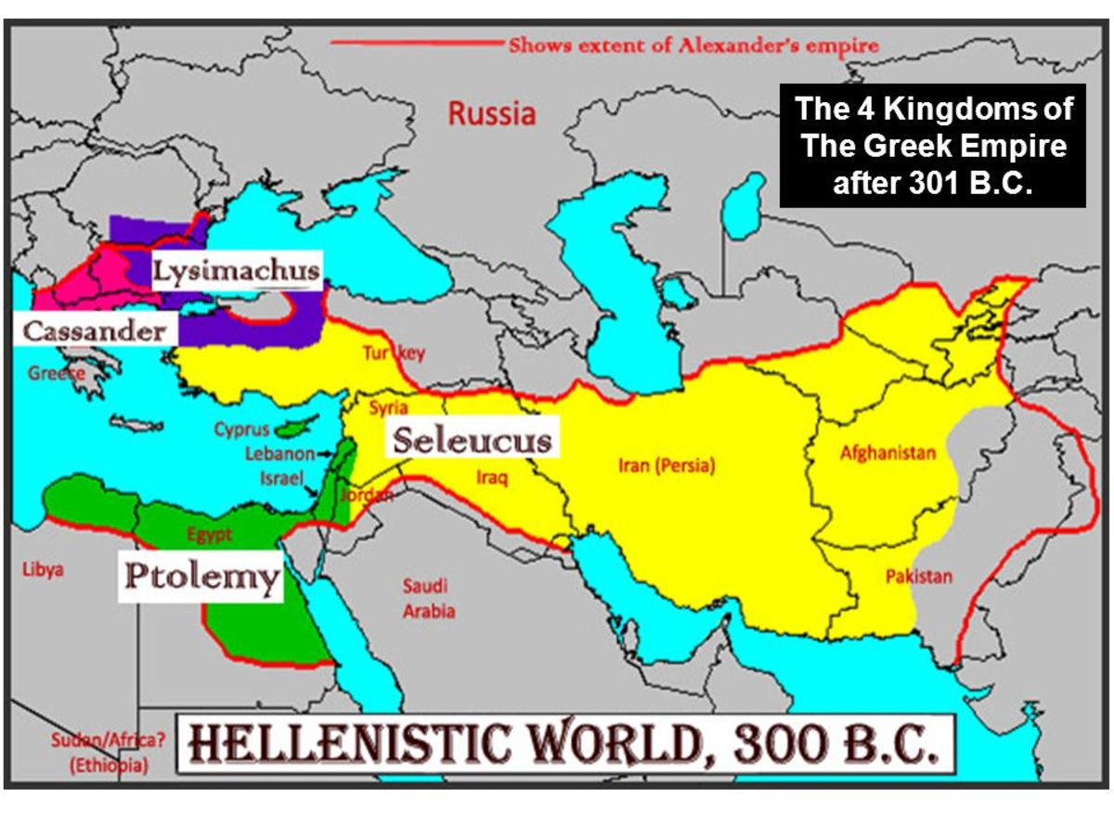
Daniel 8- The Goat
From the West (8:5), Greece (8:21)
Alexander the Great (b. 356 BC) became King of Macedonia by 336, defeated the Persians 331, and died by 323 BC.
Territory divided up by four leading generals after his death.

Slide 12
Daniel 8- The Little Horn
Antiochus IV (Epiphanes) a king of the Seleucid Dynasty (r.175-164 BC) used his cunning and cruelty against the Jews
Infamous for defiling the sanctuary, murdering those with copies of the Torah
Suffering for transgression (8:12, 23)
”For how long?” (8:13-14) – 2,300 evenings and mornings (not forever)

Slide 13
Daniel 8- Ram, Goat, & Horn
How is Chapter 8 continuing the message of the Book of Daniel so far?
How is Chapter 8 a shift in the message?
What would the original readers take from this chapter?
What do we learn from this chapter and how should we respond?

Slide 14
The Book of Daniel
Homework: Chapter 9 (Daniel’s Prayer for His People)

Slide 15
Daniel: Class Schedule
# | Date | Class | Teacher
1 | Sun 12/3 | Class Introduction & Background | Robert McDonald
2 | Sun. 12/10 | Chapter 1 | Robert McDonald
3 | Sun. 12/17 | Chapter 2 | H.E. Jenkins
4 | Sun. 12/24 | Chapter 3 | Robert McDonald
5 | Sun. 12/31 | Chapter 4 | H.E. Jenkins
6 | Sun. 1/7 | Chapter 5 | H.E. Jenkins
7 | Sun. 1/14 | Chapter 6 | Robert McDonald
8 | Sun. 1/21 | Chapter 7 | H.E. Jenkins
9 | Sun 1/28 | Chapter 8 | H.E. Jenkins
10 | Sun. 2/4 | Chapter 9 | Robert McDonald
11 | Sun. 2/11 | Chapter 10-11 | Robert McDonald
12 | Sun. 2/18 | Chapter 12 | H.E. Jenkins
13 | Sun. 2/25 | Summary and Themes | H.E. Jenkins

